Slide 1
Sberbank Russian Housing Market
A Kaggle Competition

Slide 2
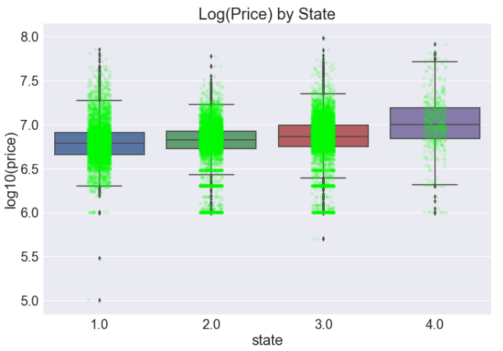
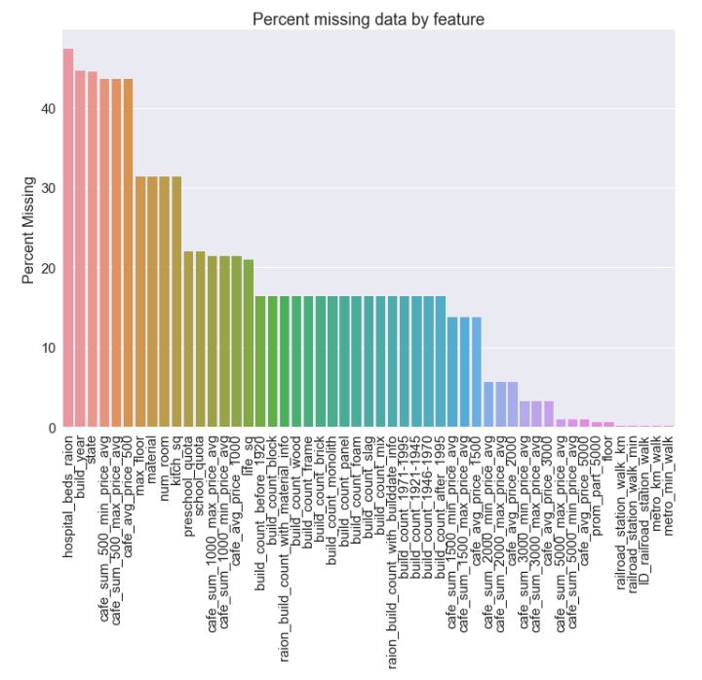
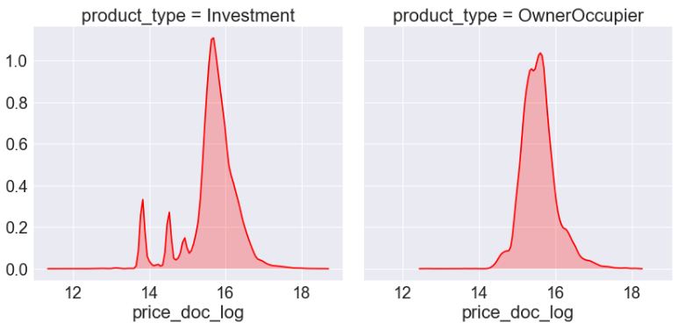
Exploratory Data Analysis
Telling graphs/stats
Wrapping our heads around this beast

Slide 3
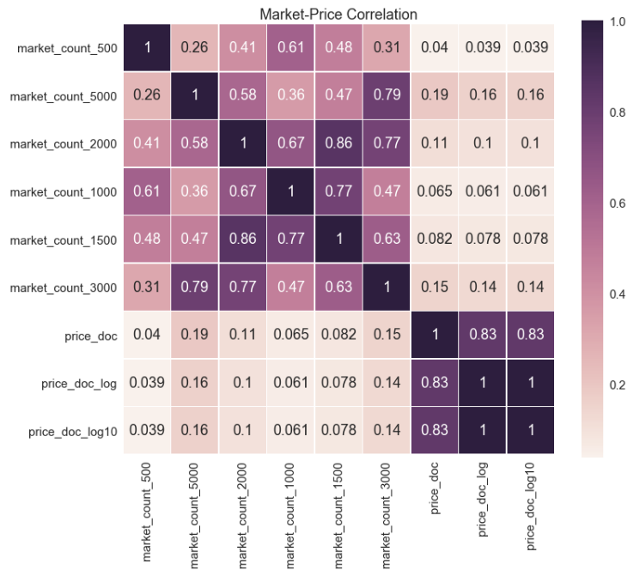
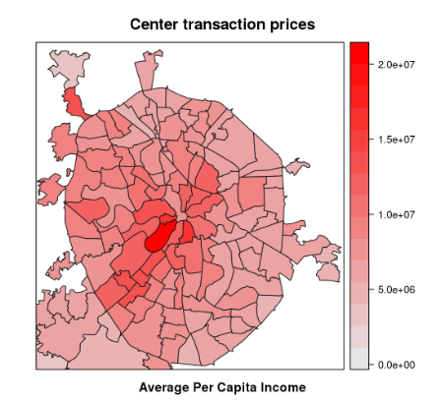
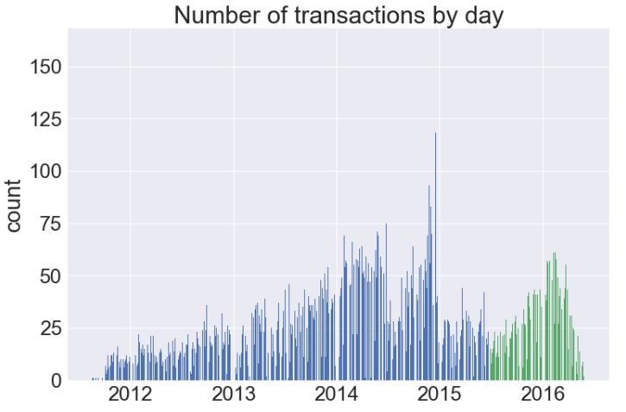

Slide 4
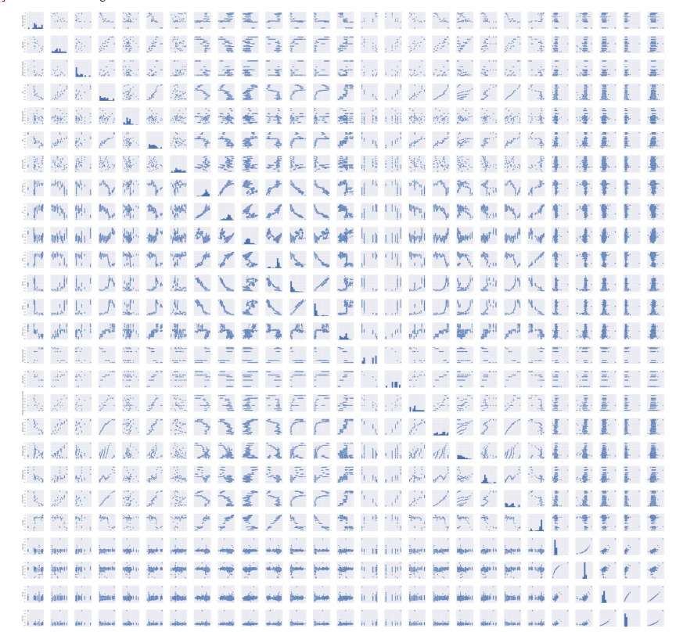
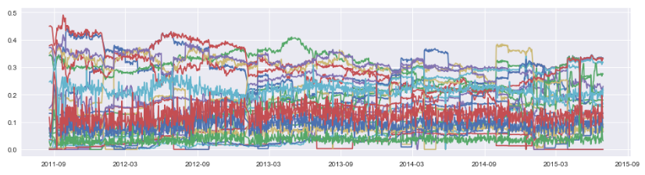
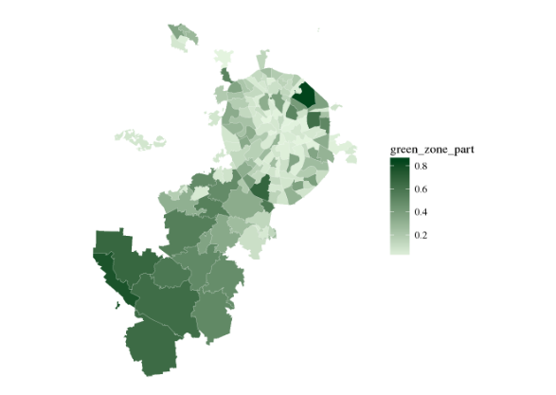

Slide 5
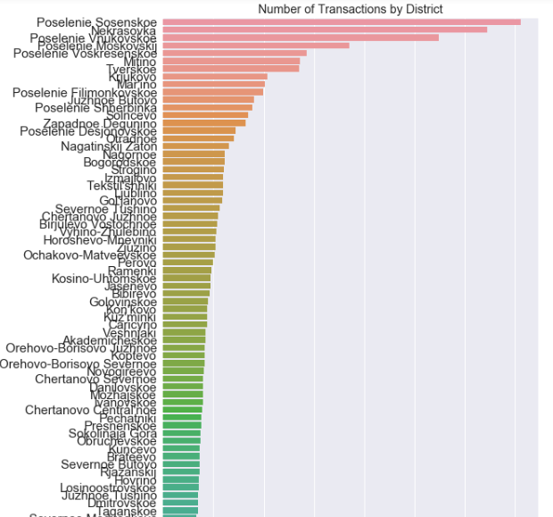
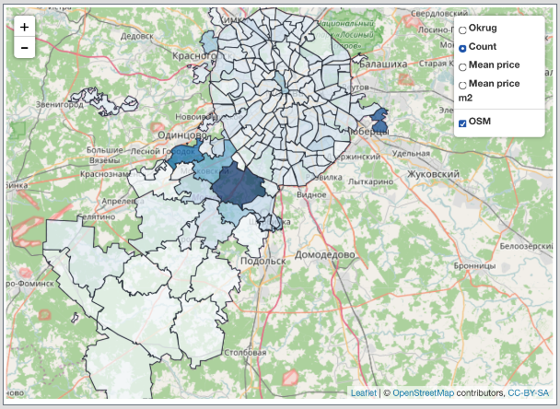

Slide 6
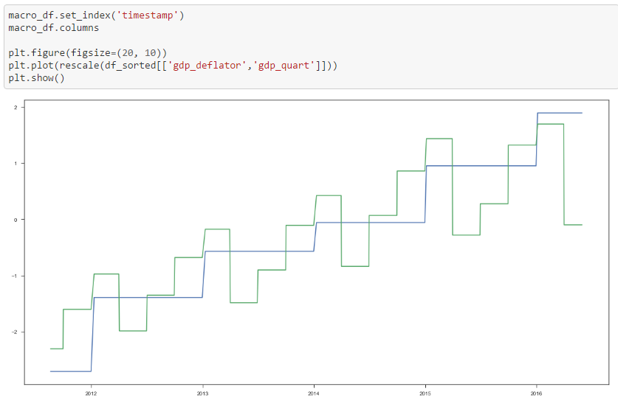

Slide 7
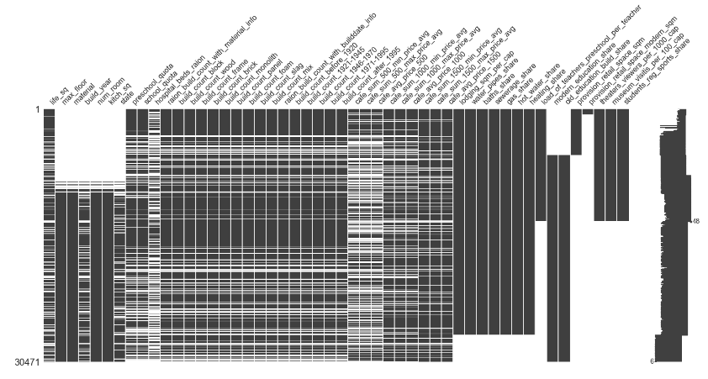
Cleaning and Imputation
Graph of missing data
Important ones to fill
If we did anything unique or different than Shu

Slide 8
A First Run Through
First trial of xgboost
Results
Our understanding

Slide 9
The Process
Infograhic of eda → cleaning → feature engineering and models and repeat

Slide 10
Feature Engineering
What to cut out/keep
New features (full_sq, ratios)
May add more for interesting findings

Slide 11
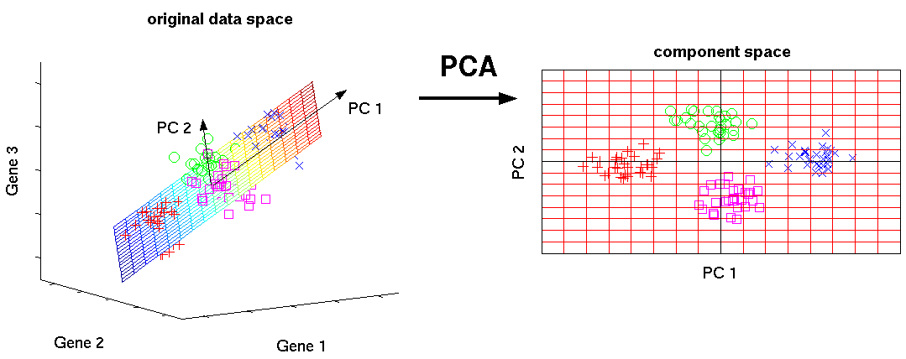
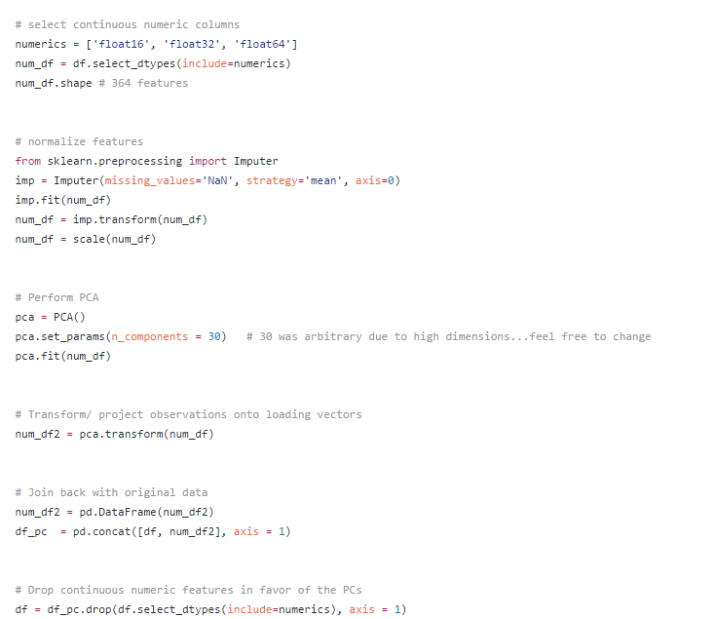
Principal Component Analysis
Deciding on params
If helpful or not
(may put this slide towards end or take out completely)
http://www.nlpca.org/fig_pca_principal_component_analysis.png

Slide 12
Linear Regression
Results with different features
Predictive rates
Multi-collinearity(?)

Slide 13
Lasso and Ridge Regularization
Which one we favored and why
Different but similar results for feature selection
How we used those results

Slide 14
Random Forest
Idea behind it
Our params
Results & tuning

Slide 15
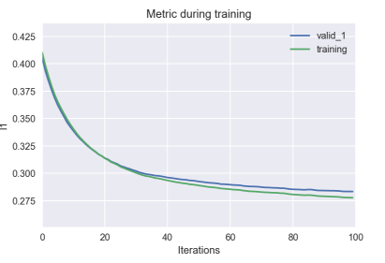
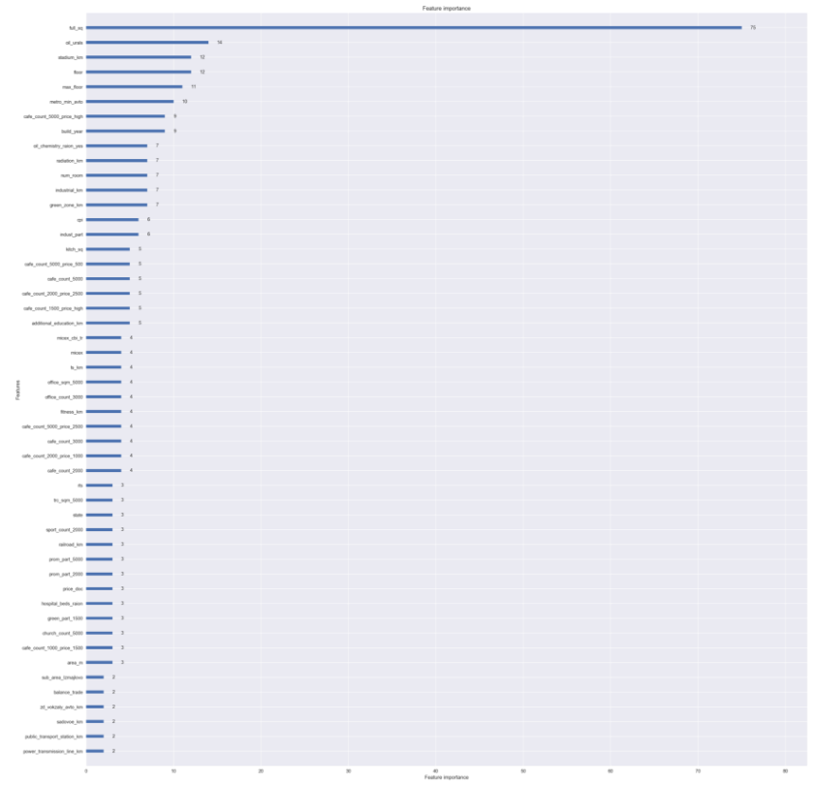
Light GBM
Params/features
Results
Interpretation

Slide 16
XGBoost
Revisited
params
Interesting results and interpretation

Slide 17
Ensemble Models (?)
…

Slide 18
Final Conclusions
Weird results:
Imputing mode best options
(any other weird experiments)

Slide 19
Further Work

Slide 20
Thank You
Andrew, Pradeep, reza, romi, sean

